Slide 1



BDM CAPSTONE PROJECT
Presented by
ENHANCING OPERATIONAL EFFICIENCY AT SFP SONS
DARSHAN GANATRA
22f2000931

Slide 2


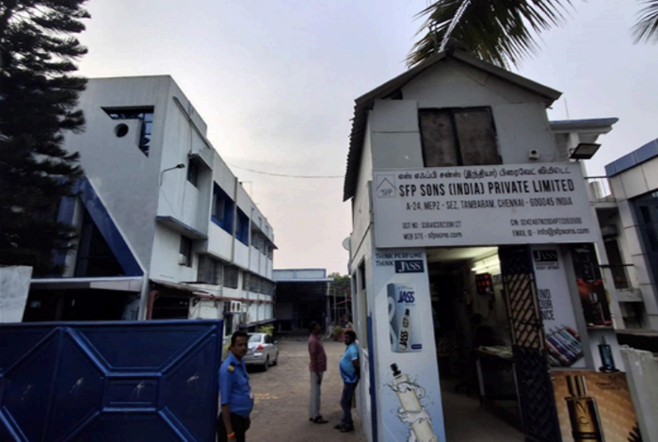
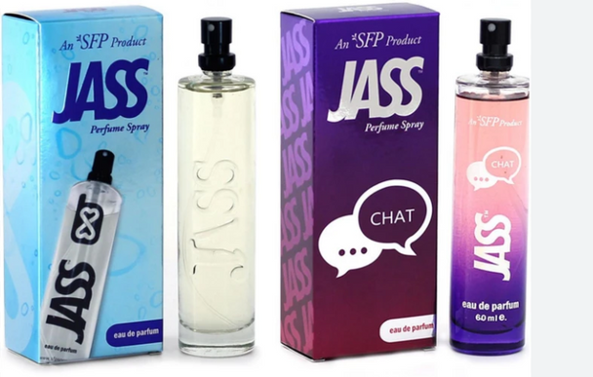
BUSINESS OVERVIEW AND CHALLENGES
SFP Sons, a B2B fragrance manufacturer founded in 2004 by Mr. Dinesh Patel, specializes in a wide range of perfumes, attars and other fragrance products. The company has a significant market presence, with a strong ution netwbork.
Despite its growth, the company struggles with key operational issues, including an imbalanced product mix and inefficient resource allocation. This has led to the overproduction of low-demand items and delays in fulfilling high-demand products, creating a fundamental disconnect between production and market needs.
This project aims to address these inefficiencies by providing a data-driven strategy to align production with market demand.

Slide 3
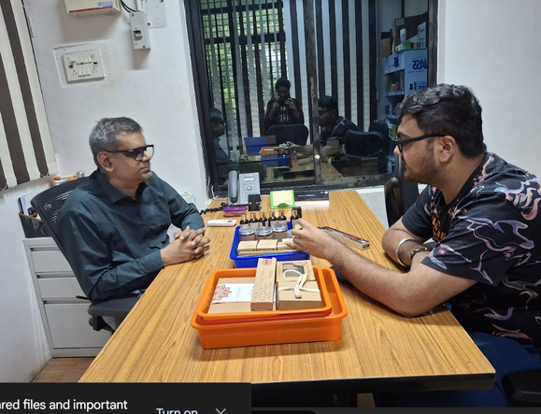
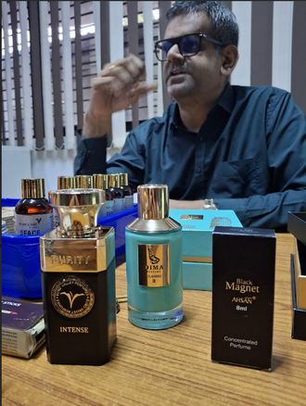

PROBLEM STATEMENT / OBJECTIVES
To optimize resource allocation by focusing production capacity on high-demand products, minimizing operational strain from an extensive product range, and enabling efficient order fulfilment that aligns with market demand.
To enhance sales and revenue through the implementation of effective production strategies that improve overall operational effectiveness and responsiveness to customer demands.

Slide 4
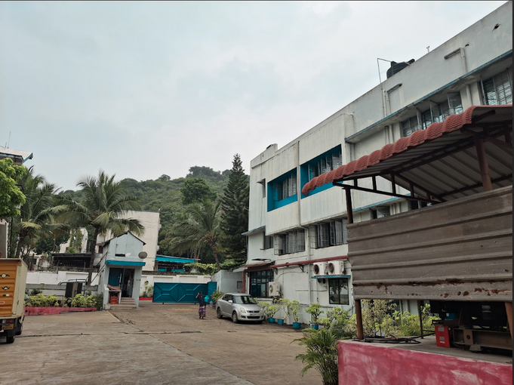
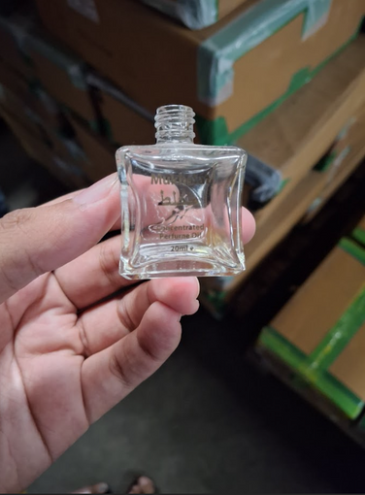




DATA COLLECTION AND PREPROCESSING
DATA COLLECTION
DATA PREPROCESSING
After a factory visit and meeting with the founder, Primary data was collected via email from the company's marketing executive.It included three key datasets: production, cost, and sales.
Production data had fields like planned and completed quantity, while cost data included opening stock and an ml-to-cost mapping. Sales data contained details like MRP, distributor rate, and final sale.
The datasets were preprocessed by standardizing column names and removing irrelevant business-specific columns also by removing records mentioned as gifts.
A key step involved extracting product volume (ML) from item names and assigning their cost by using provided ml-to-cost mapping. This process ensured all data used for analysis was consistent, accurate, and relevant.

Slide 5
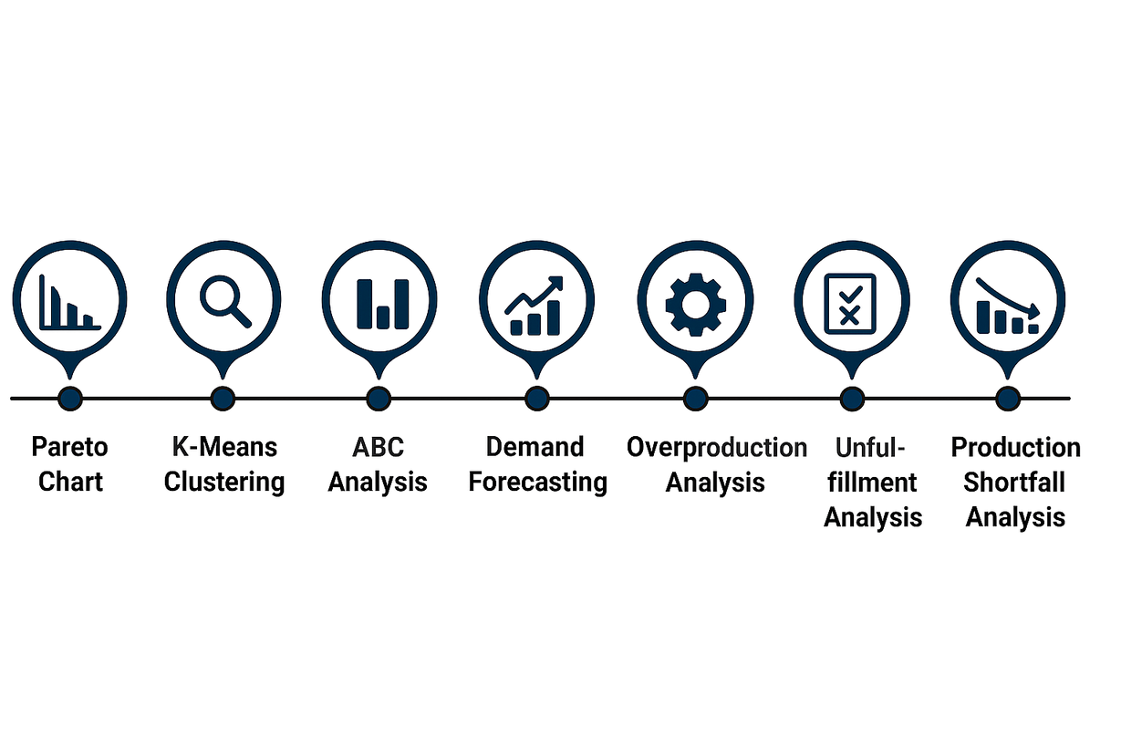
ANALYSIS METHODS
Pareto Analysis : Identified the top products contributing to 80% of sales. This justified focusing on a small, high-impact portion of the product portfolio.
K-Means Clustering : Grouped products into high, medium, and low-demand segments. This provided a data-driven way to categorize the product portfolio and identify top-performing outliers.
ABC Analysis : Categorized products into A, B, and C groups based on sales. This was crucial for prioritizing products and justifying resource allocation.
SARIMA Forecasting : Applied a time-series model SARIMA to forecast future demand for important products. This provided a proactive tool to anticipate market needs and prevent shortfalls.
Overproduction Analysis : Compared production with demand for C-items. This quantified wasted production capacity and capital spent on low-value products.
Unfulfillment Analysis : Quantified unfulfilled orders for A and B items. This identified missed sales opportunities for key products and measured operational efficiency.
Production Shortfall Analysis : Diagnosed the gap between planned and completed production. This highlighted bottlenecks and a failure to meet production targets.

Slide 6
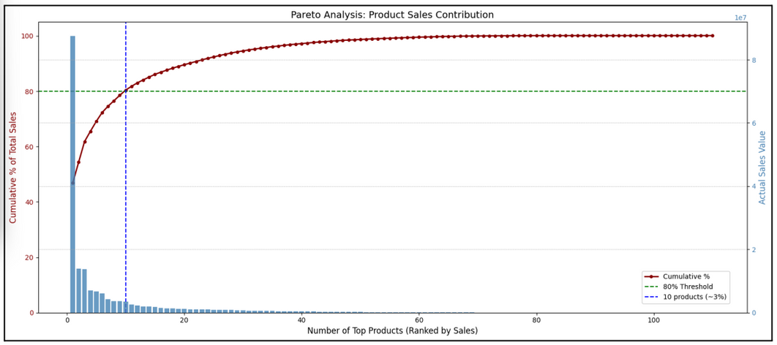
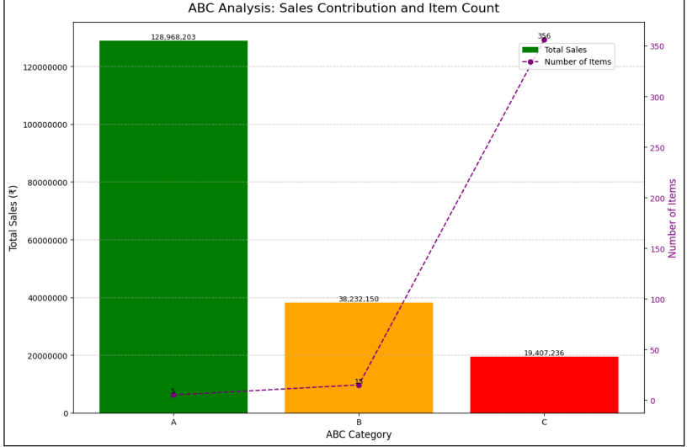

RESULTS AND FINDINGS-I
Pareto analysis reveals that approximately 10 products, representing only 3% of the total product count, contribute to nearly 80% of the overall sales revenue. This insight highlights the need to focus resources on a small, high-impact group of items rather than distributing them across the entire product catalogue
ABC analysis confirms a clear product portfolio imbalance, with just 20 SKUs in Categories A and B generating nearly 90% of total sales. This large number of low-value, Category C products (356 items) creates significant operational strain while contributing minimally to revenue.

Slide 7
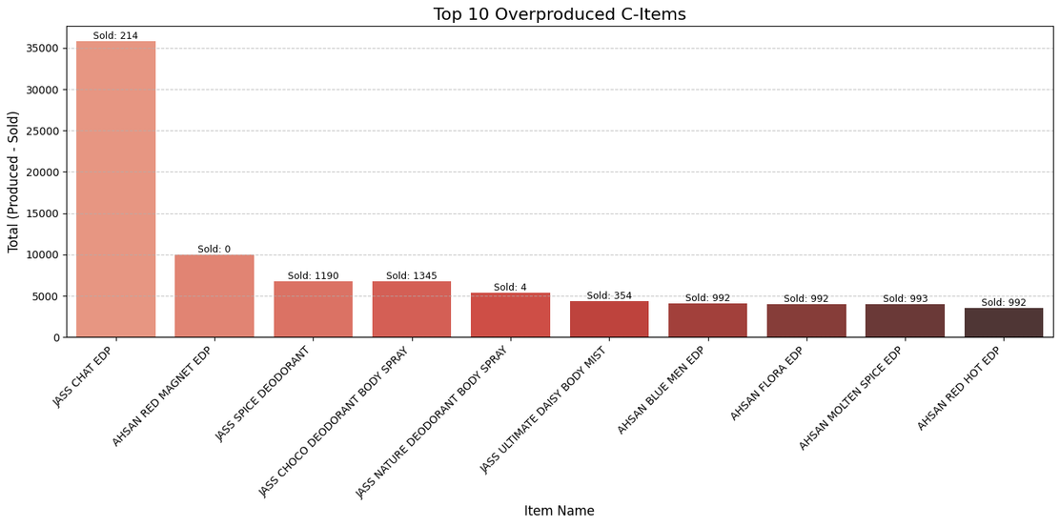
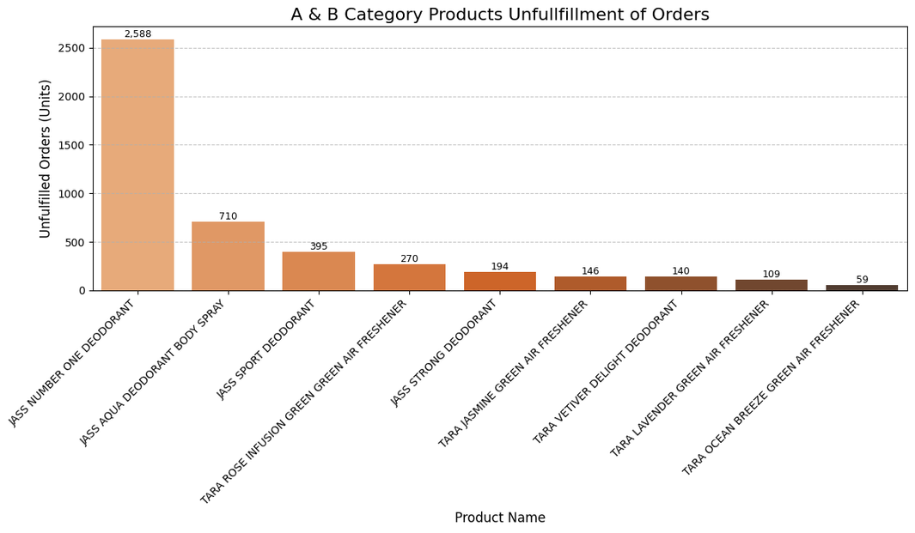
RESULTS AND FINDINGS-II
Overproduction analysis reveals a critical disconnect between production and demand, showing that resources are being drained on low-value products. Eg: JASS CHAT EDP was overproduced by over 35,000 units, consuming production capacity without generating a corresponding return in sales (Sold 214 units).
Unfulfillment analysis of A and B highlights the cost of misallocated resources, as the company is failing to meet demand for its one of the valuable items. Eg: JASS NUMBER ONE DEODORANT had the highest number of unfulfilled orders, with 2,588 units unfulfilled. This represents a direct loss of revenue and missed sales opportunities for key products that drive the majority of sales.

Slide 8
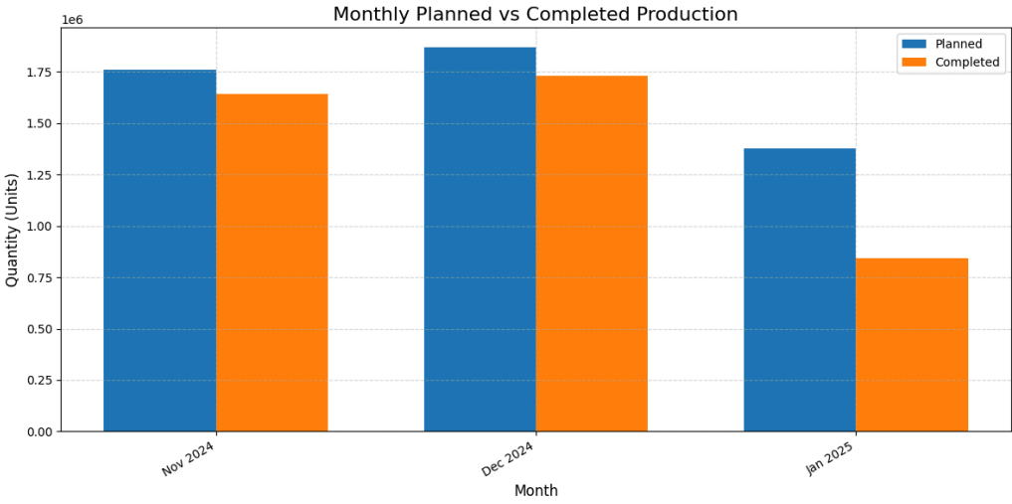
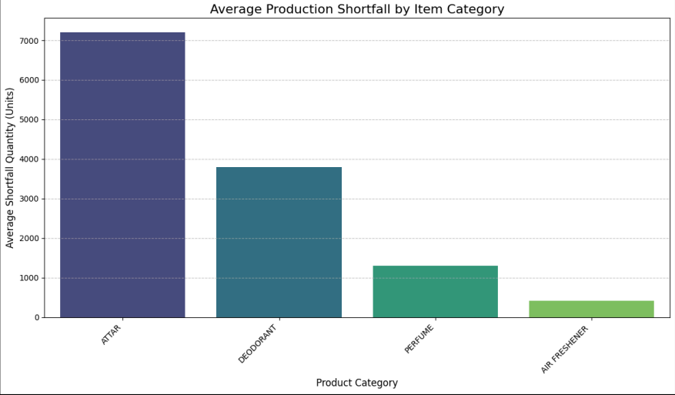
RESULTS AND FINDINGS-III
The top-right graph provides a high-level overview of production shortfalls over a three-month period. Completed production quantities consistently fell slightly short of planned targets, with the most severe shortfall occurring in January 2025. The large gap between planned and completed units in that month indicates a major production bottleneck and an inability to meet objectives.
The bottom-right graph reveals that these production issues are not uniform across the portfolio. Attar has the highest average production shortfall, followed by Deodorant. The shortfalls in these key categories are likely the primary cause of unfulfilled orders for some important products.

Slide 9
INTERPRETATION OF RESULTS
A small number of high-value products (5 Class A and 15 Class B items) generate the majority of sales, while a vast number of low-value Class C items (356 products) consume disproportionate production resources and contribute minimally to revenue. This demonstrates that the company's product diversity is an operational burden rather than a competitive advantage.
Overproduction of low-demand Class C items (e.g., JASS CHAT EDP, 35,000+ units vs. demand of 201) leads to wasted resources, high carrying costs, and factory inefficiency.Meanwhile, high-value A & B products face unfulfilled demand (e.g., JASS NUMBER ONE DEODORANT, 2,588 units short).This mismatch shows poor resource allocation, causing missed revenue opportunities and customer dissatisfaction in key product lines.
The overall production targets are missed, with a notable decline in completed units in January 2025. This is especially critical because the categories with the highest average shortfalls, Attar and Deodorant, contain the highest-value products. This indicates a fundamental operational bottleneck that is directly impacting the company's revenue and ability to meet customer expectations

Slide 10
RECOMMENDATIONS
FOR THE BUSINESS
Focused Product Strategy : Deprioritize Category C items through a product rationalization process, discontinuing those with persistently low or zero demand (e.g., JASS CHAT EDP, AHSAN RED MAGNET EDP). The freed capacity and capital can then be reallocated to high-demand A and B products, reducing operational strain and improving order fulfillment efficiency.
Implement a Forecast-Driven Production Model: Integrate SARIMA demand forecasts into the monthly planning cycle for high-value items. This will enable the company to anticipate market trends and prevent production shortfalls that lead to unfulfilled orders.
Optimize Critical Production Lines: Conduct a process audit, such as Value Stream Mapping, on the Attar and Deodorant production lines to identify and eliminate bottlenecks. Investing in these high-priority lines can significantly increase throughput and consistency.
Establish a Fulfillment KPI:A new Key Performance Indicator (KPI) should be established to monitor the fulfillment rate of all Category A and B products on an ongoing basis. An ideal target fulfillment rate of at least 98% should be set to guide future decisions and ensure continuous improvement

